Slide 1
Introduction to Probability and Statistics
Fourteenth Edition
Chapter 9
Large-Sample Tests of Hypotheses

Slide 2

Introduction
Suppose that a pharmaceutical company
is concerned that the mean potency μ of an antibiotic meet the minimum government potency standards. They need to decide between two possibilities:
  The mean potency μ does not exceed the mean allowable potency.
  The mean potency μ exceeds the mean allowable potency.
This is an example of a test of hypothesis.

Slide 3

Introduction
Similar to a courtroom trial. In trying a person for a crime, the jury needs to decide between one of two possibilities:
  The person is guilty.
  The person is innocent.
To begin with, the person is assumed innocent.
The prosecutor presents evidence, trying to convince the jury to reject the original assumption of innocence, and conclude that the person is guilty.
Notes:
3

Slide 4
Parts of a Statistical Test
The null hypothesis, H₀:
  Assumed to be true until we can prove otherwise.
The alternative hypothesis, H_{a}:
  Will be accepted as true if we can disprove H₀
Court trial: Pharmaceuticals:
H₀: innocent H₀: μ does not exceeds allowed amount
H_{a}: guilty H_{a}: μ exceeds allowed amount
Notes:
4

Slide 5
Parts of a Statistical Test
The test statistic and its p-value:
A single statistic calculated from the sample which will allow us to reject or not reject H₀, and
A probability, calculated from the test statistic that measures whether the test statistic is likely or unlikely, assuming H₀ is true.
The rejection region:
  A rule that tells us for which values of the test statistic, or for which p-values, the null hypothesis should be rejected.
Notes:
5

Slide 6
Parts of a Statistical Test
Conclusion:
  Either “Reject H₀” or “Do not reject H₀”, along with a statement about the reliability of your conclusion.
How do you decide when to reject H₀?
  Depends on the significance level, α, the maximum tolerable risk you want to have of making a mistake, if you decide to reject H₀.
  Usually, the significance level is α = .01 or α = .05.
Notes:
6

Slide 7
A Large-Sample Test about a Population Mean
Let μ₀ be a hypothesized value of μ.
A one tailed test:
    H₀: μ = μ₀ vs. H_{a}: μ > μ₀ (right-tailed test)
    H₀: μ = μ₀ vs. H_{a}: μ < μ₀ (left-tailed test)
A two-tailed test:
  H₀: μ = μ₀ vs. H_{a}: μ ≠ μ₀

Slide 8
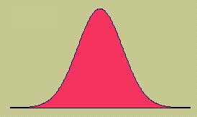
Test Statistic
Assume to begin with that H₀ is true. The sample mean is our best estimate of μ, and we use it in a standardized form as the test statistic:
since has an approximate normal distribution with mean μ₀ and standard deviation .
Notes:
8

Slide 9
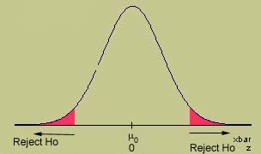
Test Statistic
If H₀ is true the value of should be close to μ₀, and z will be close to 0. If H₀ is false, will be much larger or smaller than μ₀, and z will be much larger or smaller than 0, indicating that we should reject H₀.
Notes:
9

Slide 10
Example 1
The mayor of a small city claims that the average income per family in his city is more than 50,000 baht per month with a standard deviation of 3000 baht. Thus,
H₀: μ = 50,000 baht vs. H_{a}: μ > 50,000 baht
Is it true that the mean time to finish an exam is different from 90 minutes? Thus,
H₀: μ = 90 min vs. H_{a}: μ ≠ 90 min

Slide 11

Example 2
A homeowner randomly samples 64 homes similar to her own and finds that the average selling price is $252,000 with a standard deviation of $15,000. Is this sufficient evidence to conclude that the average selling price is greater than $250,000? Use α = .01.
H₀ : μ = 250,000
H_{a} : μ > 250,000
Notes:
ICSC 303 - Statistics
11

Slide 12
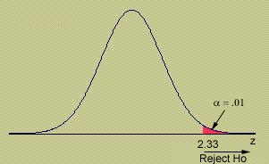
Critical Value Approach
What is the critical value of z that cuts off exactly α= .01 in the right-tail of the z distribution?
For our example, z = 1.07 does not fall in the rejection region and H₀ is not rejected.
There is not enough evidence to indicate that μ is greater than $250,000.
Rejection Region: Reject H₀ if z > 2.33.

Slide 13
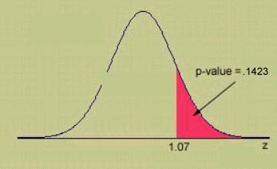
p-Value Approach
The probability that our sample results or something even more unlikely would have occurred just by chance, when μ = 250,000.
Since p-value > α = 0.01, H₀ is not rejected.
There is insufficient evidence to indicate that μ is greater than $250,000.

Slide 14
Example 3
The daily yield for a chemical plant has averaged 880 tons for several years. The quality control manager wants to know if this average has changed. She randomly selects 50 days and records an average yield of 871 tons with a standard deviation of 21 tons. At 1% significance level what would she conclude?
H₀ : μ = 880
vs. H_{a} : μ ≠ 880

Slide 15
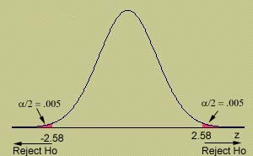
Critical Value Approach
If α = 0.01, what is the critical value of z that cuts off exactly α/2 = 0.01/2 = 0.005 in the tail of the z distribution?
For our example,
z = -3.03 falls in the rejection region and H₀ is rejected at the 1% significance level. Thus, the average yield is different from 880 tons.
Rejection Region: Reject H₀ if z > 2.58 or z < -2.58.

Slide 16
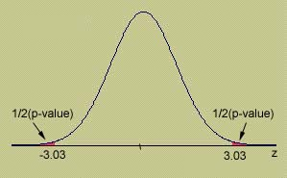
p –Value Approach
What is the probability that this test statistic or something even more extreme (far from what is expected if H₀ is true) could have happened just by chance?
Since our p-value = 0.0024 is less than α=0.01, we reject H₀ and conclude that the average yield has changed.

Slide 17
Class Activity
Source: Exercise 9.14, Introduction to Prob. & Stat, W.M., R.B, and B. B.
Many companies are becoming involved in flextime, in which a worker schedules his or her own work hours or compresses work weeks. A company that was contemplating the installation of a flextime schedule estimated that it needed a minimum mean of 7 hours per day per assembly worker in order to operate effectively. Each of a random sample of 80 of the company’s assemblers was asked to submit a tentative flextime schedule. If the mean number of hours per day for Monday was 6.7 hours and the standard deviation was 1.2 hours, do the data provide sufficient evidence to indicate that the mean number of hours worked per day on Mondays, for all of the company’s assemblers, will be less than 7 hours? Test using 0.05 level of significance.
Notes:
17

Slide 18
Class Activity
For each of the following find the appropriate rejection region(s) for the large-sample test statistic z.
  A right-tailed test with α = 0.05
  A left-tailed test with α = 0.05
  A two-tailed test with 3% significance level
Notes:
18

Slide 19
Class Activity
Test H₀ : μ = 30 vs. H_{a} : μ > 30 using the p-value approach. Given that a sample of n = 36 yields
= 32, and s = 5.
Notes:
19

Slide 20
Class Activity
Find the p-value for the following large-sample z test:
  A left-tailed test with observed z = -2.14
  A two-tailed test with observed z = -2.14
Notes:
20

Slide 21
LIKELY OR UNLIKELY?
Once you’ve calculated the observed value of the test statistic, calculate its p-value:
p-value: The probability of observing, just by chance, a test statistic as extreme or even more extreme than what we’ve actually observed. If H₀ is rejected this is the actual probability that we have made an incorrect decision.
If this probability is very small, less than some preassigned significance level, α, H₀ can be rejected.
Notes:
21

Slide 22

Using a Rejection Region
If α = .01, what would be the critical
value that marks the “dividing line” between “not rejecting” and “rejecting” H₀?
If p-value < α, H₀ is rejected.
If p-value > α, H₀ is not rejected.
The dividing line occurs when p-value = α. This is called the critical value of the test statistic.
Test statistic > critical value implies p-value < α, H₀ is rejected.
Test statistic < critical value implies p-value > α, H₀ is not rejected.
Notes:
22

Slide 23
Statistical Significance
The critical value approach and the p-value approach produce identical results.
The p-value approach is often preferred because
  Computer printouts usually calculate p-values
  You can evaluate the test results at any significance level you choose.
What should you do if you are the experimenter and no one gives you a significance level to use?

Slide 24
Statistical Significance
If the p-value is less than .01, reject H₀.
The results are highly significant.
If the p-value is between .01 and .05, reject H₀. The results are statistically significant.
If the p-value is between .05 and .10, do not reject H₀. But, the results are tending towards significance.
If the p-value is greater than .10, do not reject H₀. The results are not statistically significant.

Slide 25
Two Types of Errors
There are two types of errors which can
occur in a statistical test.
Actual Fact Jury’s Decision | Guilty | Innocent
Guilty | Correct | Error
Innocent | Error | Correct
Actual Fact Your Decision | H₀ true (Accept H₀) | H₀ false (Reject H₀)
H₀ true (Accept H₀) | Correct | Type II Error
H₀ false (Reject H₀) | Type I Error | Correct
Define:
α = P(Type I error) = P(reject H₀ when H₀ is true)
β =P(Type II error) = P(accept H₀ when H₀ is false)
Notes:
25

Slide 26
Two Types of Errors
We want to keep the probabilities of
error as small as possible.
The value of α is the significance level, and is controlled by the experimenter.
The value of β is difficult, if not impossible to calculate.
Rather than “accepting H₀” as true without being able to provide a measure of goodness, we choose to “not reject” H₀.
We write: There is insufficient evidence to reject H₀.
Notes:
26

Slide 27
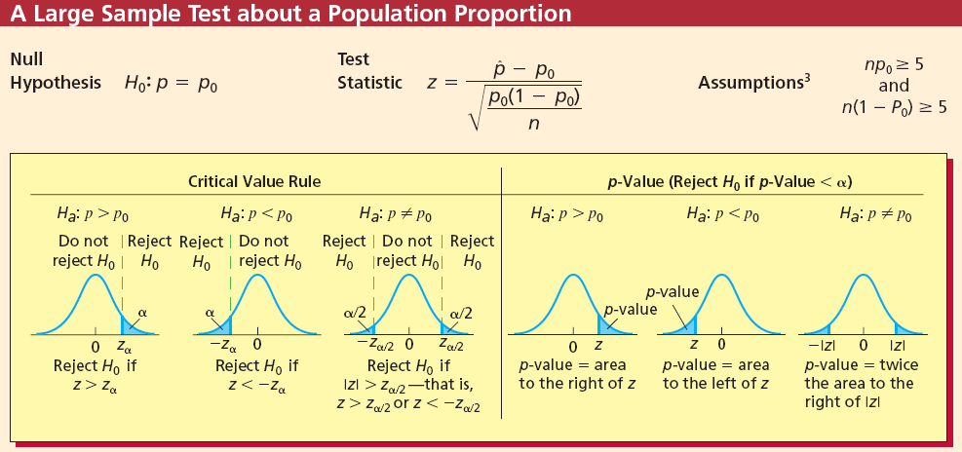
z Tests about a Population Proportion
LO 5: Use critical values and ρ-values to perform a large sample z test about a population proportion.
9-27
Notes:
Hypothesis testing can also be performed on proportions. These tests work similarly to hypothesis testing using the standard normal distribution to test the mean. That is, reject the null hypothesis that the population proportion equals some hypothesized value at the alpha level of significance if and only if the appropriate rejection point rule, or equivalently, the corresponding p-value is less than alpha.
In general, we have the following three rules:
One, for an alternative hypothesis that the population proportion exceeds some value, reject the null hypothesis if the test statistic exceeds the critical value from the standard normal distribution. This point will have alpha percent of the area to its right.
Two, for an alternative hypothesis that the population proportion is less than some value, reject the null hypothesis if the test statistic is less than the critical value from the standard normal distribution. This point will have alpha percent of the area to its left.
Three, for an alternative hypothesis that the population proportion is not equal to some value, reject the null hypothesis if the test statistic is greater than the absolute value of the critical value from the standard normal distribution. This point will have alpha divided by two percent of the area to its right with the same area to the left of its negative value.
The formula for the test statistic is shown on the slide. Note that p hat is the sample proportion and p sub zero is the hypothesized proportion.

Slide 28
Example: The Cheese Spread Case
LO5
Recall that p is the proportion of all current purchasers who would stop buying the cheese spread if the new spout were used. In order to provide evidence that the new spout is profitable, we wish to demonstrate that p is less than 0.1. We can attempt to do this by testing H₀ : p=0.1 versus H_{a} : p < 0.1. Suppose that 1,000 soft cheese spread purchasers are randomly selected to test the new spout. We find that 63 of these purchasers say they would stop buying the spread if the new spout were used. Make you own conclusion, at level of significance of 0.01.
9-28

Slide 29
Example: The Cheese Spread
Case (Continued)
1. Check assumptions: np >=5 and n(1-p) >=5.
2. Find z statistic
3. z=-3.90 < z_(-0.01) which is about -2.33, so we reject H₀ and conclude that p < 0.1.

